Slide 1
COOP Application
Leadership
Notes:
Greeting
Introduction
Dept/Div
Office Location on Campus
EOC Location

Slide 2
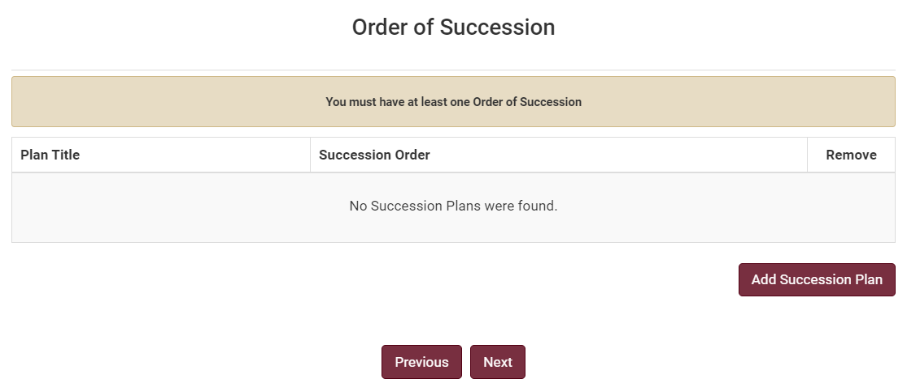
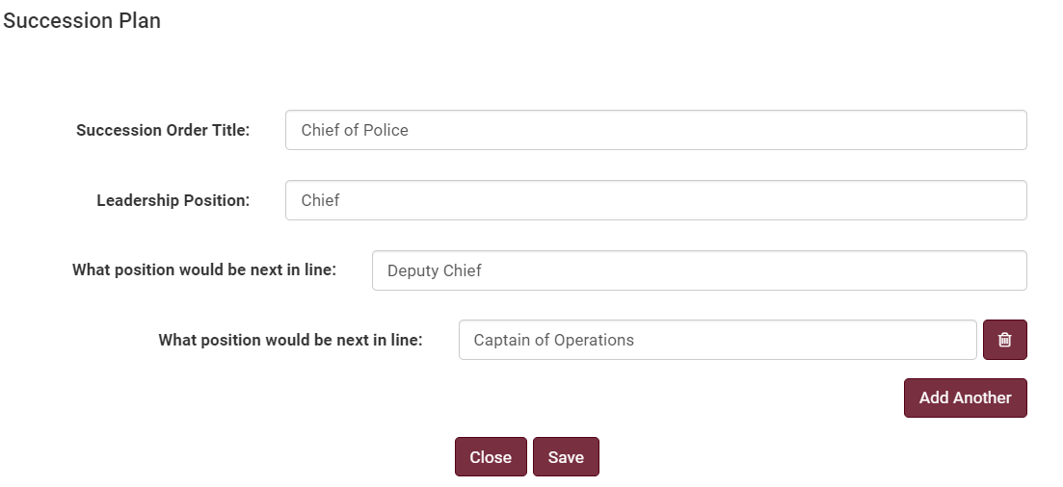
Order of Succession
Positions such as facility managers, researchers, administrators, etc. that serve in essential roles, should be considered in your COOP development. There must be at least one entry for the Department Head/Director/Dean of the University Unit. If the University Unit is made up of several departments each Department Head/Director/Dean should have a succession plan added. Additional plans may be added for other leadership positions.
To add your succession plan, click “Add Succession Plan”.
Enter the succession order title. An example of a succession title is included in the screenshot below.
Select the Leadership Position of the highest order position from the drop-down menu. Enter the position that would be next in line. Click “Add Another” to continue the order of succession through as many tiers as necessary.
Click “Save” after you have entered your Succession Plan. This will take you back to Order of Succession.
Click “Next” and the system will redirect you to the next screen.
Need Help?
If you are working remotely, ensure you are connected to the VPN.
Google Chrome is the preferred browser for the COOP application. There may be delays or content that does not download in other browsers.

Slide 3
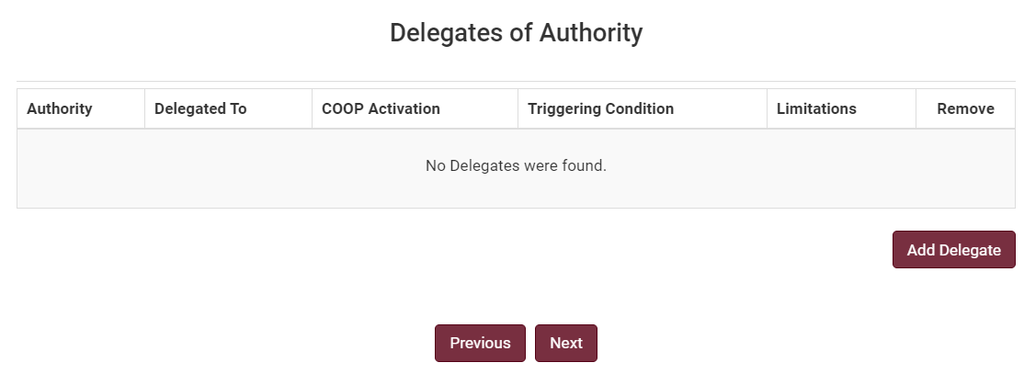
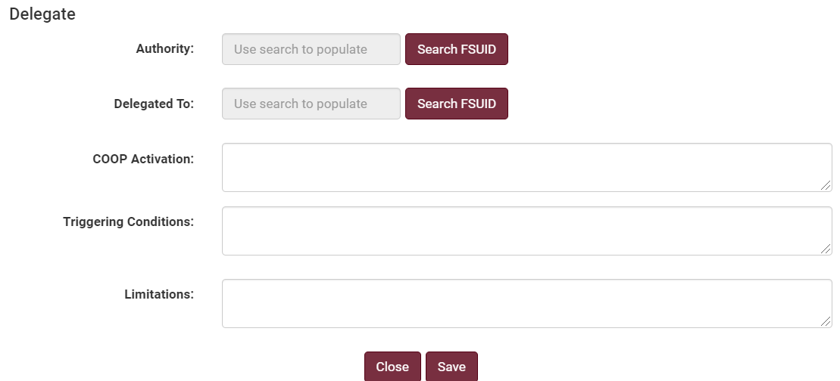
Delegates of Authority
Identify, by position, the authorities for making policy determinations and decisions for your university unit. Some examples of delegations of authority may include COOP activation, signatory, contract or grant commitments, regulatory obligations, and financial obligations. The template provides university units with the ability to define and limit any delegation of authority. For instance, financial delegation may include a limit to the funding that may be committed. There is no requirement to include delegates of authority in your plan.
To add a delegation, click “Add Delegate”.
Identify the person to which the authority currently belongs by searching for their name, FSUID, or Employee ID.
Identify the person to which the authority will be delegated to by searching for their name, FSUID, or Employee ID.
Entering a COOP Activation into the textbox is encouraged but not required. Triggering Conditions and Limitations are both required fields.
Click “Save” then click “Next” and the system will redirect you to the next screen.

Slide 4
Questions
Katelyn White, Planning Manager
Email: EM-COOP@fsu.edu

