Slide 1
COOP Application
Plans and Procedures
Notes:
Greeting
Introduction
Dept/Div
Office Location on Campus
EOC Location

Slide 2
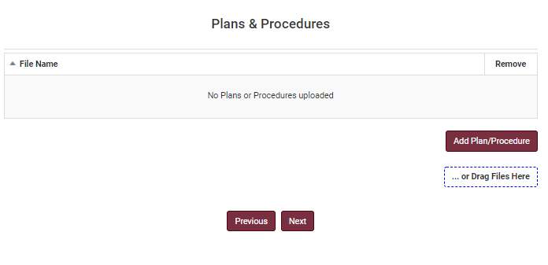
Plans and Procedures
Each University Unit should develop Standard Operating Procedures (SOPs) specific to the overall organizational mission. Plans at a minimum should identify the mechanisms used by the university unit to communicate pertinent information internally among employees.
There are two ways to add your Standard Operating Procedures to your COOP.
You can drag your files to the designated area from your computer hard drive and then it will upload in the box above.
Or click “Add Plan/Procedure”, the system will redirect you to the next screen, click “Choose Files” to choose a file from your computer hard drive.
Click “Save” to store the file and repeat the process for any remaining plans and procedures.
Click “Next” and the system will redirect you to the next screen.
Need Help?
If you are working remotely, ensure you are connected to the VPN.
Google Chrome is the preferred browser for the COOP application. There may be delays or content that does not download in other browsers.

Slide 3
Questions
Katelyn White, Planning Manager
Email: EM-COOP@fsu.edu

