Slide 1
COOP Application
Recovery
Notes:
Greeting
Introduction
Dept/Div
Office Location on Campus
EOC Location

Slide 2
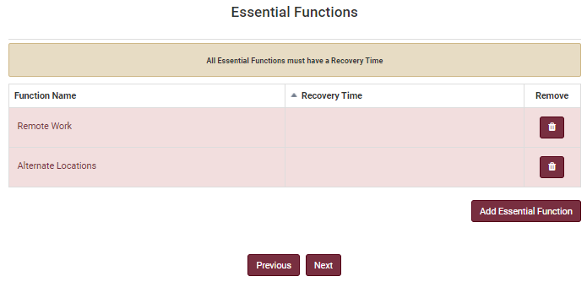
Recovery: Essential Functions
An effective COOP documents the processes providing for redundancy of key information, necessary to maintain essential functions. Essential functions are defined as services, programs, or activities which may not sustain an interruption greater than 30 days for the university unit to continue operating at normal status.
Two essential functions are already listed on the page. You must click each item and add their target recovery time. Next to the Recovery Time heading there is a dropdown menu for you to choose the number of hours of need recovery time for the selected function.
The option to customize the function’s recovery time is also provided. You may select any number of minutes, hours, days, or week needed for recovery.
Click “Save”, this will take you back to the Essential Functions page.
Need Help?
If you are working remotely, ensure you are connected to the VPN.
Google Chrome is the preferred browser for the COOP application. There may be delays or content that does not download in other browsers.

Slide 3
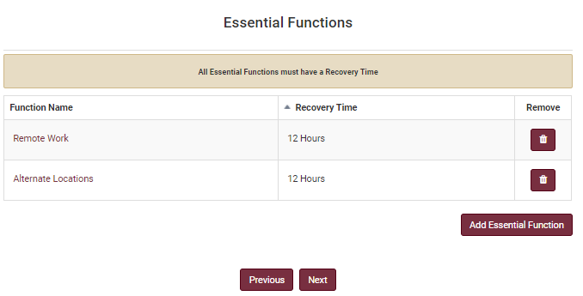
Recovery: Essential Functions
An effective COOP documents the processes providing for redundancy of key information, necessary to maintain Essential Functions. Essential functions are defined as services, programs, or activities which may not sustain an interruption greater than 30 days for the university unit to continue operating at normal status.
To add an Essential Function, click “Add Essential Function”. You will be prompted to either select a default function from a dropdown menu or input your own unique essential function. You will also need to provide the function’s recovery time as previously described.
Some examples of essential functions are:
Academic Advising
Academic Instruction
Basic Utilities (e.g., power, water, waste removal)
Budget and Finance Administration
Facility Operations
IT Services
Research (e.g., Operations, Data Collection, Animal Care)
Click “Next” and the system will redirect you to the next screen.
Need Help?
If you are working remotely, ensure you are connected to the VPN.
Google Chrome is the preferred browser for the COOP application. There may be delays or content that does not download in other browsers.

Slide 4
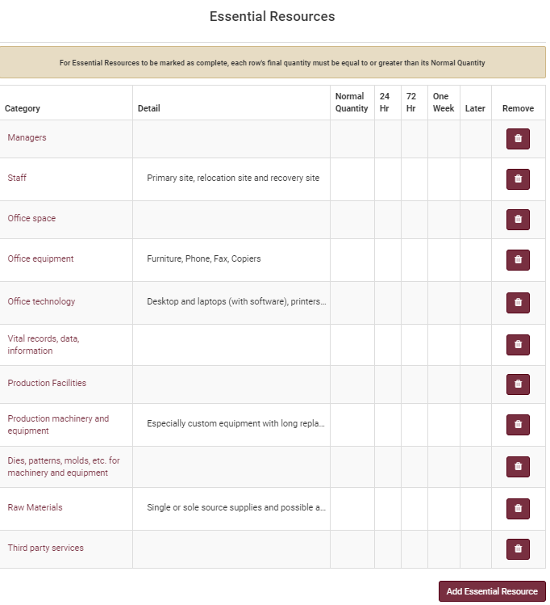
Recovery: Essential Resources
The Essential Resources screen is used to identify the type of resource(s) that would be needed for the essential functions of the university unit. Resources may include equipment, facilities, people, supplies, and other specialized services.
Several essential resources are already listed on the page. To edit these resources, click on their category name. Add any necessary details in the Detail textbox.
Enter the normal quantity of this resource, the quantity needed for a day’s work, three days’ work, one week of work, and how much will be needed for anytime later than a week.
Click “Save” and the system will take you back to the Essential Resources page.
To add an Essential Resource, click “Add Essential Resource”. You will be prompted to input your own unique essential resource. You will also need to provide the resource’s details and quantities as previously described.
Click “Next” and the system will redirect you to the next screen.
Need Help?
If you are working remotely, ensure you are connected to the VPN.
Google Chrome is the preferred browser for the COOP application. There may be delays or content that does not download in other browsers.

Slide 5
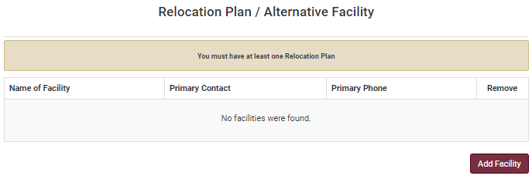
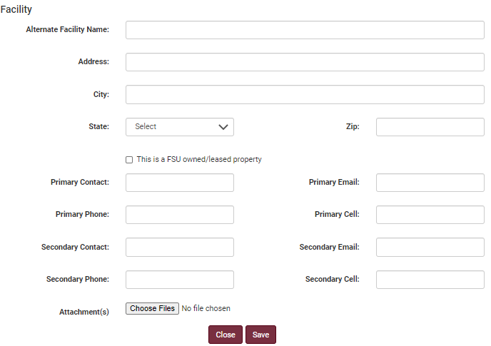
Recovery: Relocation Plan/Alternative Facility
The COOP Coordinator should designate an alternate operating facility with sufficient space, equipment, infrastructure systems, and logistical support to maintain operations for up to 30 days. The University is unlikely to be able to designate an alternate facility for each unit due to fiscal and resource availability constraints. In order to assist in relocation, the units should detail space requirements to sustain essential function performance in this section. Attachments such as space plans/blueprints or leases can be uploaded in this section as well. University units should consider the approximate square footage or specialized rooms and/or laboratories that may be needed to continue their essential functions
To add a facility, click “Add Facility”. This will take you to a page that will require location information about the facility as well as a primary and secondary contact.
Indicate whether the facility is FSU owned or leased property and attach any space plans/blueprints or leases for the facility.
Click “Save”. Repeat the process to add other alterative facilities. Then click “Next” and the system will redirect you to the next screen.
Need Help?
If you are working remotely, ensure you are connected to the VPN.
Google Chrome is the preferred browser for the COOP application. There may be delays or content that does not download in other browsers.

Slide 6
Questions
Katelyn White, Planning Manager
Email: EM-COOP@fsu.edu

