Slide 1
COOP Application
Login and Personal Details
Notes:
Greeting
Introduction
Dept/Div
Office Location on Campus
EOC Location

Slide 2
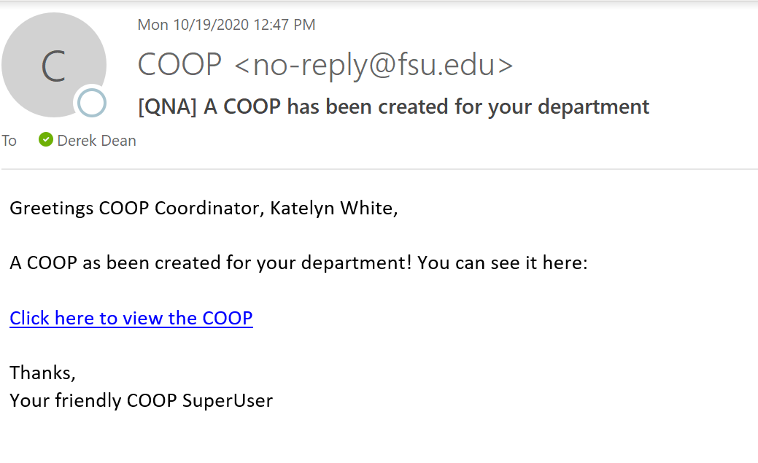
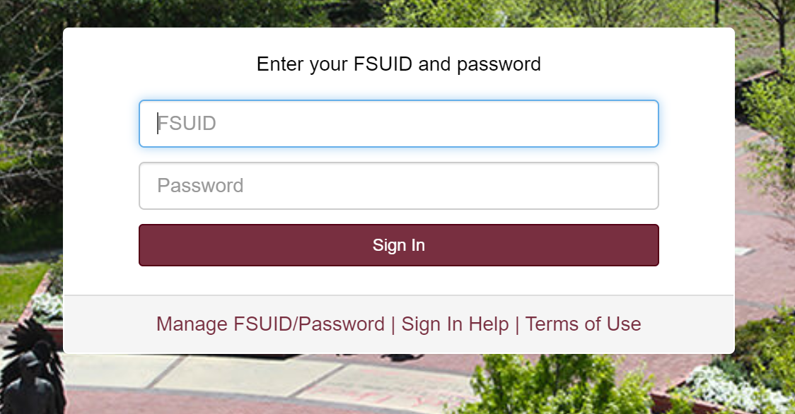
Site Login
https://apps.its.fsu.edu/COOP/app/adminconsole/
Click the link above to be directed to the COOP application.
You can also access the COOP application through link provided in the e-mails from the COOP application.
Log in through Single Sign-On with your FSUID and Password.
As a COOP Coordinator, once you are redirected to the COOP app home page you will see your University Unit name.
Click on the name of the University Unit to be directed to the plan.
Need Help?
If you are working remotely, ensure you are connected to the VPN.
Google Chrome is the preferred browser for the COOP application. There may be delays or content that does not download in other browsers.

Slide 3
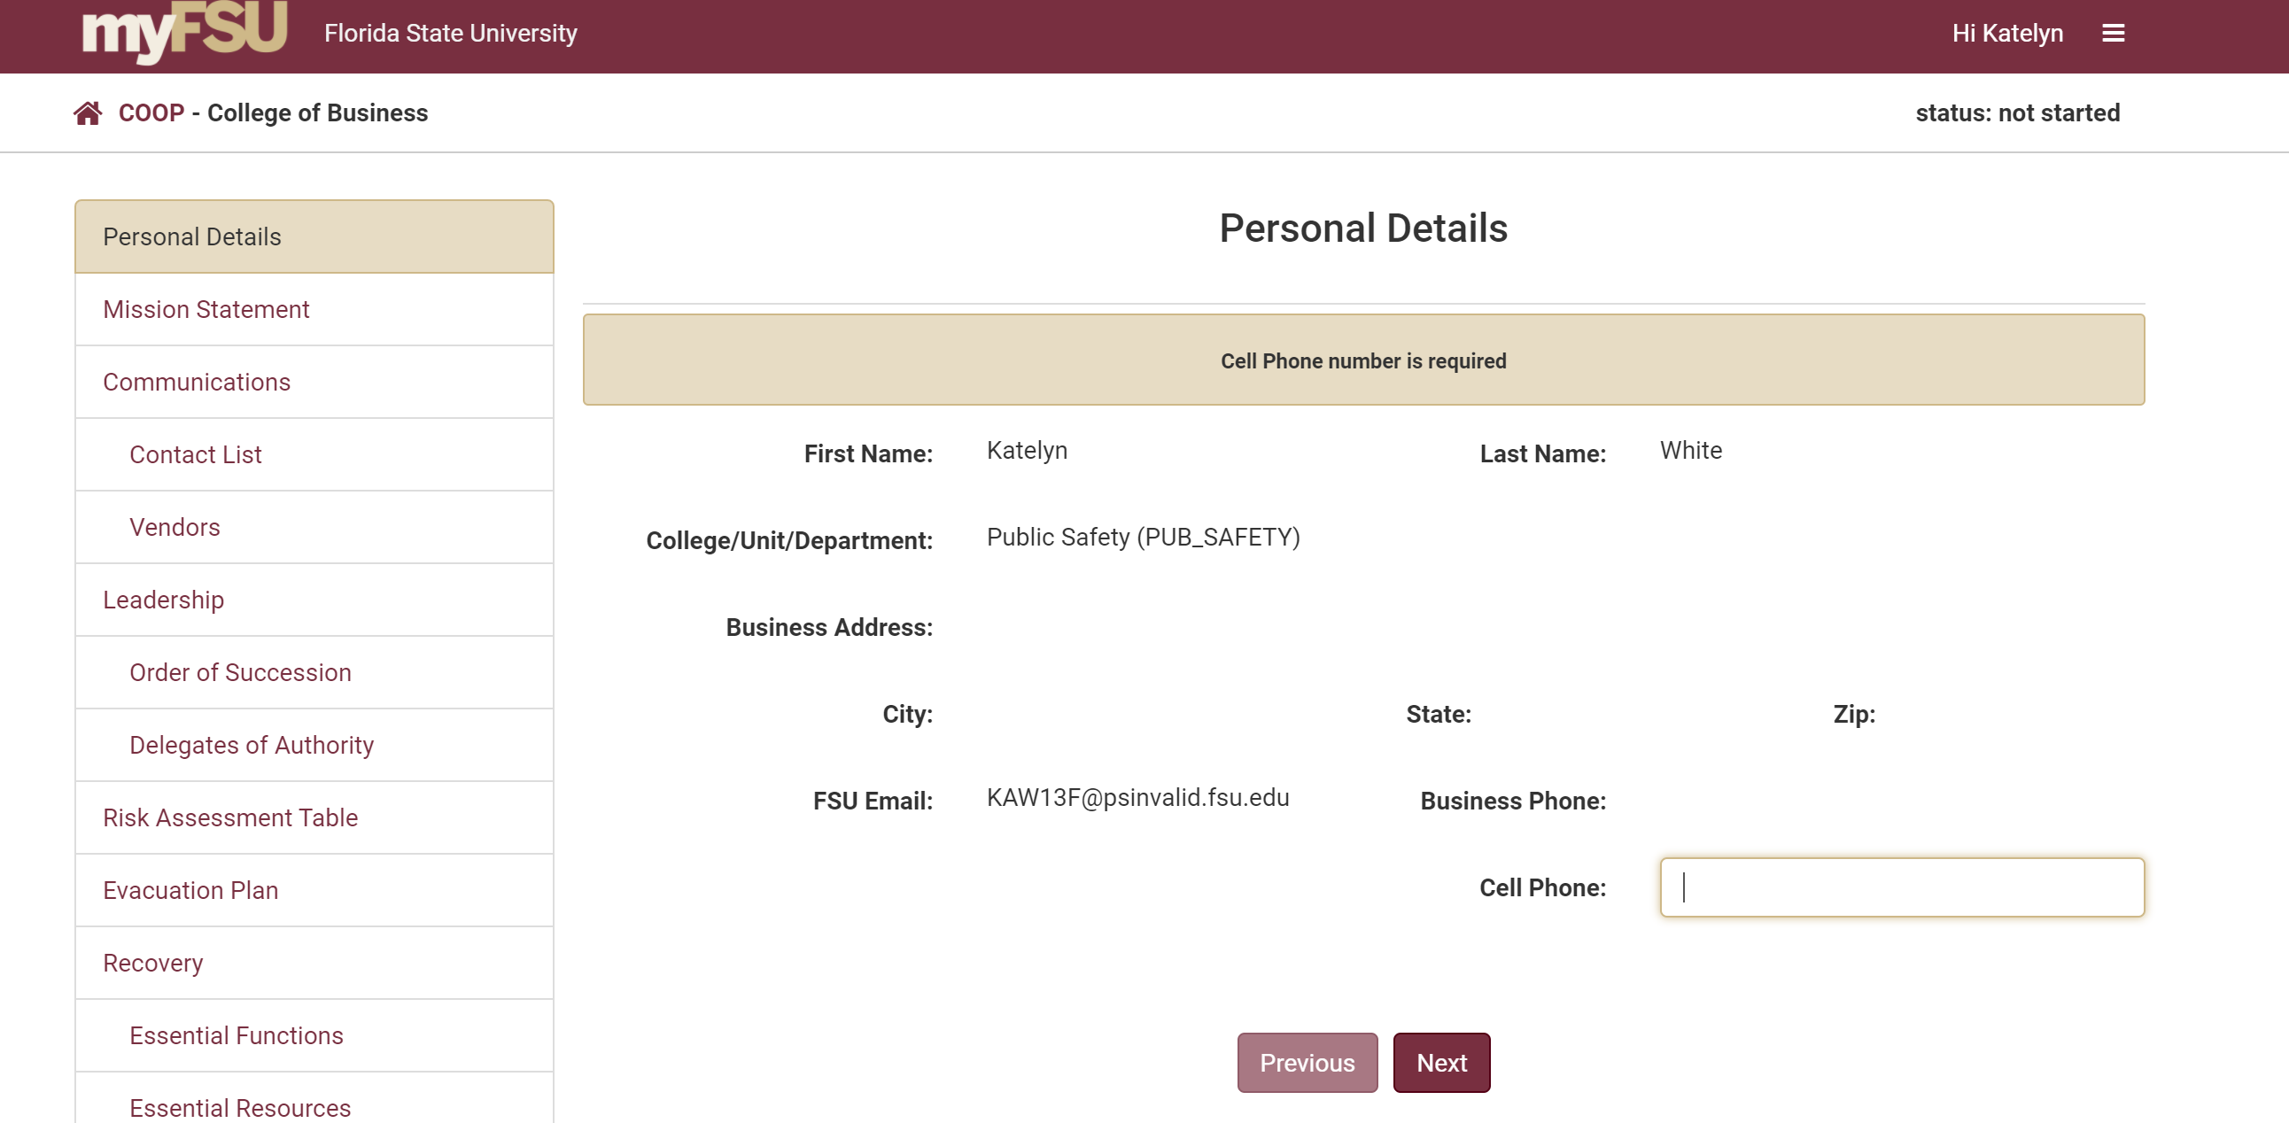
Personal Details
After you click the University Unit name you will be directed to the Personal Details screen.
You will need to enter your cell phone into the box highlighted in gold.
After you enter your information click “Next”.
Personal Details is now complete and you will be redirected to the next screen.
Need Help?
If you are working remotely, ensure you are connected to the VPN.
Google Chrome is the preferred browser for the COOP application. There may be delays or content that does not download in other browsers.

Slide 4
Questions
Katelyn White, Planning Manager
Email: EM-COOP@fsu.edu

