Slide 1
COOP Application
Troubleshooting
Notes:
Greeting
Introduction
Dept/Div
Office Location on Campus
EOC Location

Slide 2
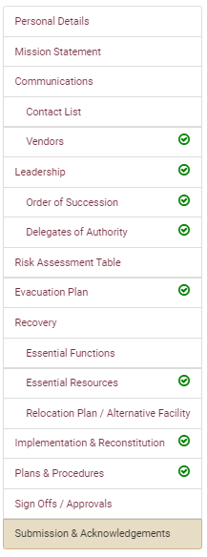
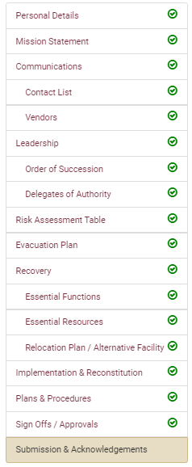
Troubleshooting
If you are working remotely, ensure you are connected to the VPN.
Sign in with your current FSUID and password.
Google Chrome is the preferred browser for the COOP application. There may be delays or content that does not download when using other browsers.
If there is a required field the system will highlight the error in red when you click “Save” or “Next”, that field must be completed before you can move on or it will not save changes.
Anytime you assign someone in the system you can search by name, FSUID, or Employee ID. When you select a person, you will be required to enter their cell phone before you click “Save”.
All COOPs are due each year by April 1st. University units that require additional assistance should reach out to FSU Emergency Management.
System issues and errors can be reported to FSU Emergency Management by emailing EM-COOP@fsu.edu.
If you have completed your COOP and have an issue with submitting check to ensure that all the main components have a green check next to each step. Click on any steps that do not have a green check and complete the section.

Slide 3
Questions
Katelyn White, Planning Manager
Email: EM-COOP@fsu.edu

